Slide 1
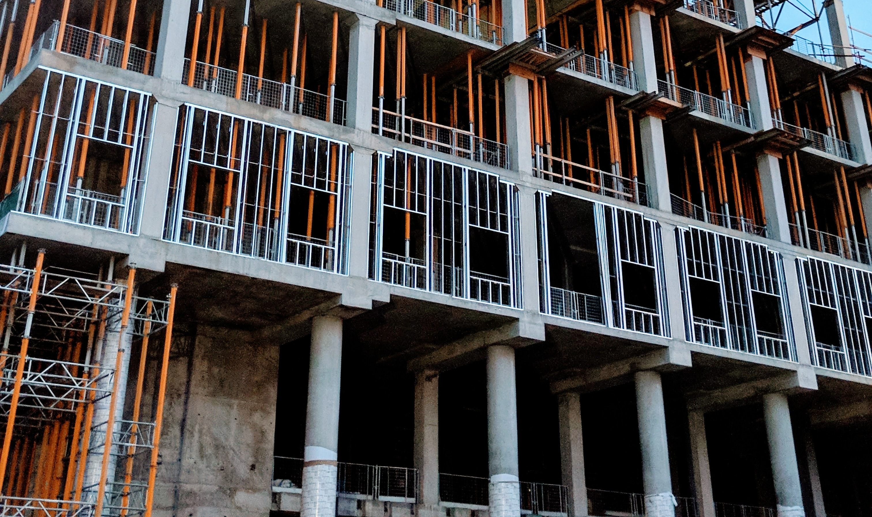
WHY WE DON’T HAVE THIS INSTEAD OF…
Notes:
This could be easy the look of the Sagrada Familia…

Slide 2
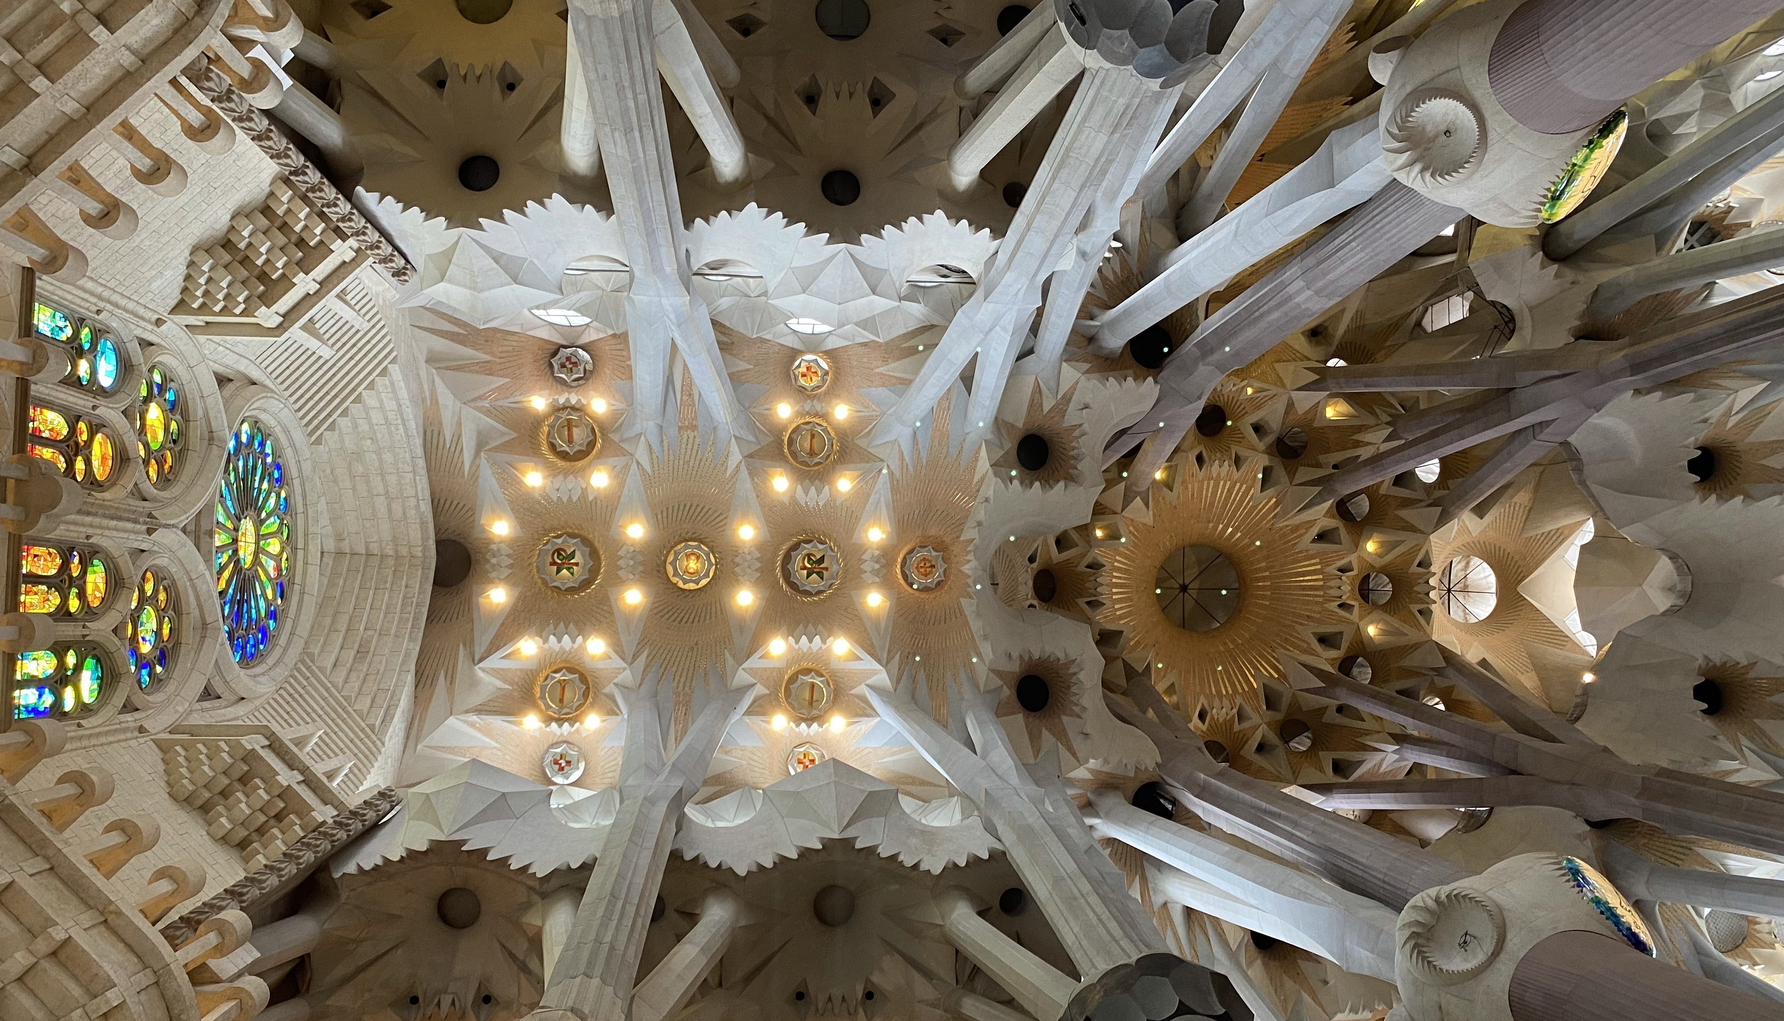
THIS?

